Slide 1
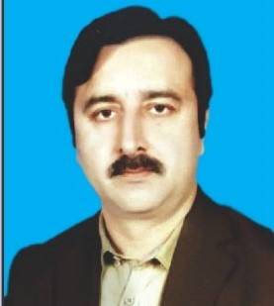
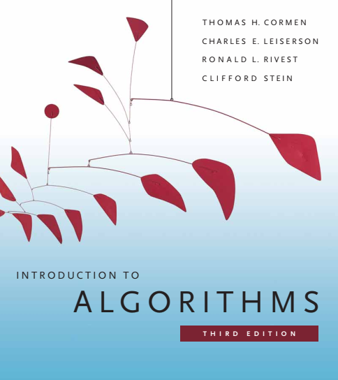
Design and Analysis of Algorithms
Dr. Sajid Iqbal
sajidiqbal.pk@gmail.com
Reference Book
Introduction to Algorithms 3rd Edition By Thomas H. Cormen et. al.
https://mitpress.mit.edu/books/introduction-algorithms-third-edition
COMEDXD

Slide 2
Lower bounds for sorting

Slide 3
Decision Tree
It is powerful and popular tool for classification and prediction
It is predictive modelling tool that has applications spanning a number of different areas
It is tree like structure
Each node in the tree represents a test on data/attribute
Each branch from the tree represents the outcome of test
Each leaf node represents the final outcome of the tree model
Binary Decision Tree (DT): It is a full binary tree that represents the comparisons between elements performed by a particular sorting algorithm on given input

Slide 4
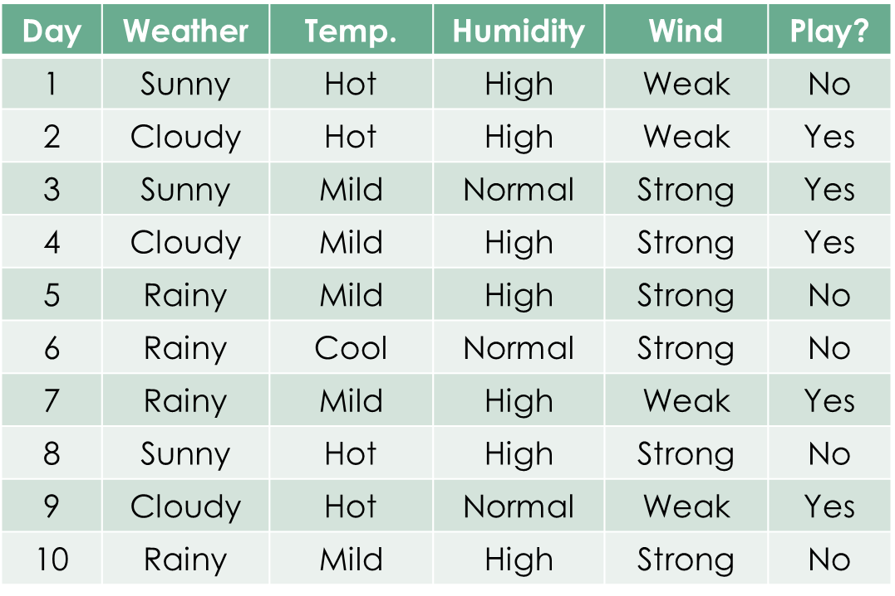
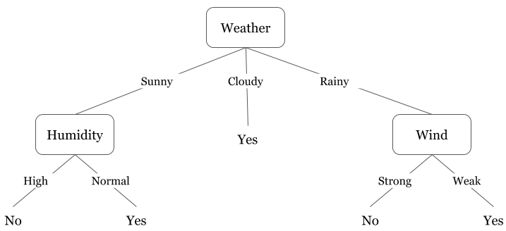
Decision Tree Example

Slide 5
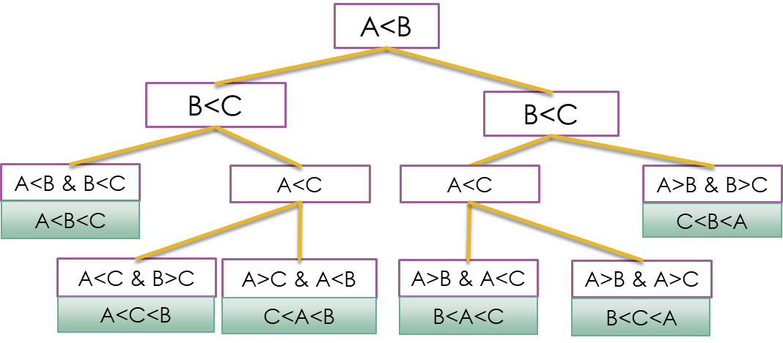
Background
Comparison Sort: A sort algorithm that sorts input numbers by comparing them with each other
comparison sorts abstractly in terms of decision trees
Worst case: occurs when decision is made from root to deepest child
Yes
No

Slide 6

Worst case lower bound
Theorem 8.1: Any comparison sort algorithm requires$Ω(n\lg{n})$ comparisons in the worst case.
Proof: Consider a DT in which each permutation appears as a reachable leaf
Let $h$ is the height of DT and $l$ are reachable leaves
Each of $n!$ permutations of the input appears as some leaf
For 3 input, permutations are $3!=(1,2,3),(1,3,2),(2,3,1),(2,1,3),(3,1,2),(3,2,1)$
$n!≤l$
A binary tree of height $h$ has no more than $2^{h}$ leaves: $n!≤l≤2^{h}$
$n!≤l≤2^{h}→2^{h}≥l≥n!→\log\left(2^{h}\right)≥\log\left(n!\right)→h≥log⁡(n!)$
$h≥\log\left(n!\right)→h≥Ω(nlogn)$ using Stirling's approximation

Slide 7

Corollary 8.2
Heapsort and merge sort are asymptotically optimal comparison sorts
Proof: Using theorem 8.1 we can map $O\left(nlog n\right)$ upper bounds on the running times for heapsort and merge sort match the $Ω\left(nlogn\right)$ worse case lower bound

Slide 8

Thanks for watching
Dr. Sajid Iqbal
Assistant Professor
Department of Computer Science
Bahauddin Zakariya University, Multan
sajidiqbal.pk@gmail.com
YouTube Channel: COMEDXD
Allah Hafiz

Slide 9
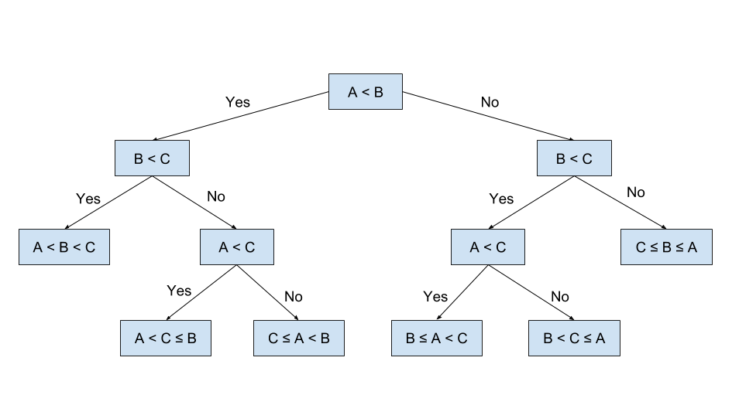
A<B
B<C
B<C
A<B & B<C
A<C
A<C
A>B & B>C
A<B<C
C<B<A
A<C & B>C
A>C & A<B
A>B & A<C
A>B & A>C
A<C<B
C<A<B
B<A<C
B<C<A

Slide 10
Day | Weather | Temp. | Humidity | Wind | Play?
1 | Sunny | Hot | High | Weak | No
2 | Cloudy | Hot | High | Weak | Yes
3 | Sunny | Mild | Normal | Strong | Yes
4 | Cloudy | Mild | High | Strong | Yes
5 | Rainy | Mild | High | Strong | No
6 | Rainy | Cool | Normal | Strong | No
7 | Rainy | Mild | High | Weak | Yes
8 | Sunny | Hot | High | Strong | No
9 | Cloudy | Hot | Normal | Weak | Yes
10 | Rainy | Mild | High | Strong | No

